Slide 2
Porter 5 Forces Analysis
Low Barriers of Entry
Growth of FinTech / Challenger Banks
Banking is being unbundled
Threat of
New Entrants
Power of Customers
Threat of Substitutes
Power of Supplier
[High]
Competitive
Rivalry
[Low]
[High]
[High]
[Low]

Slide 3
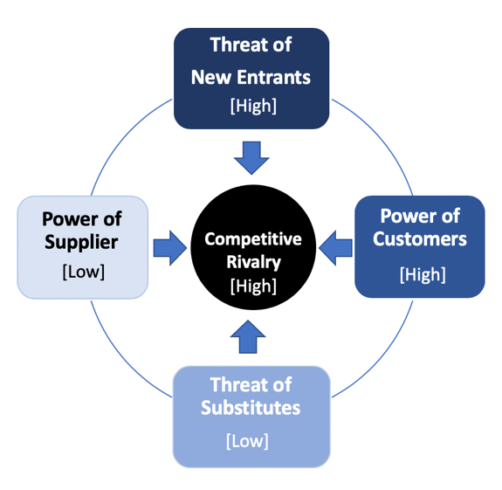
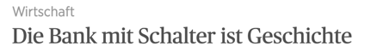
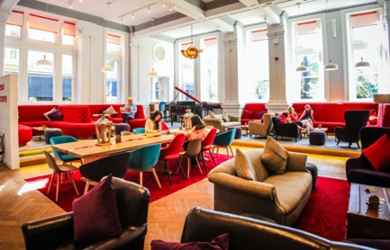
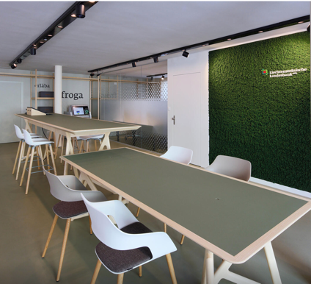
Competitive Rivalry > High
Transforming from a place you go to, to something you do.
Swiss banks no enjoys the same safe haven of banking secrecy as previously
Negative Interest and Low Yields is impacting revenue streams
Bank
Branch
Transformation
Some branches hope to act as a secondary office space or meeting space to save anyone sick of working in their cubicle.
Notes:
https://www.businessinsider.sg/these-8-banks-are-putting-hipster-cafes-to-shame-with-rainbow-furniture-coffee-bars-and-a-grand-piano/

Slide 4
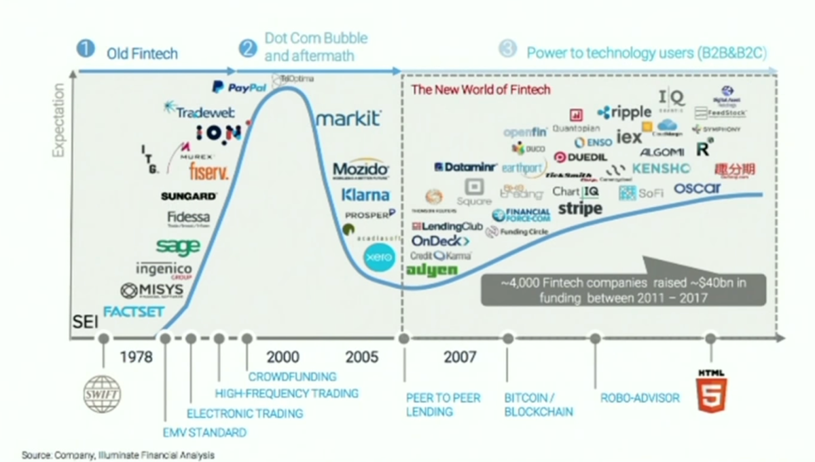
Threat of New Entrants > High
Challenger FinTech are challenging the Incumbents
FinTech are leading the way for unbundling banking
Strong Adoption of Digital Technologies
Fintech has transformed our global Financial Services Industry in the past 10 years
Notes:
https://www.youtube.com/watch?v=5hpUffu41K8&list=PL8J9g_UZHhLAB2tSXFE49x2g1EyjygRXO&index=14&t=143s

Slide 5
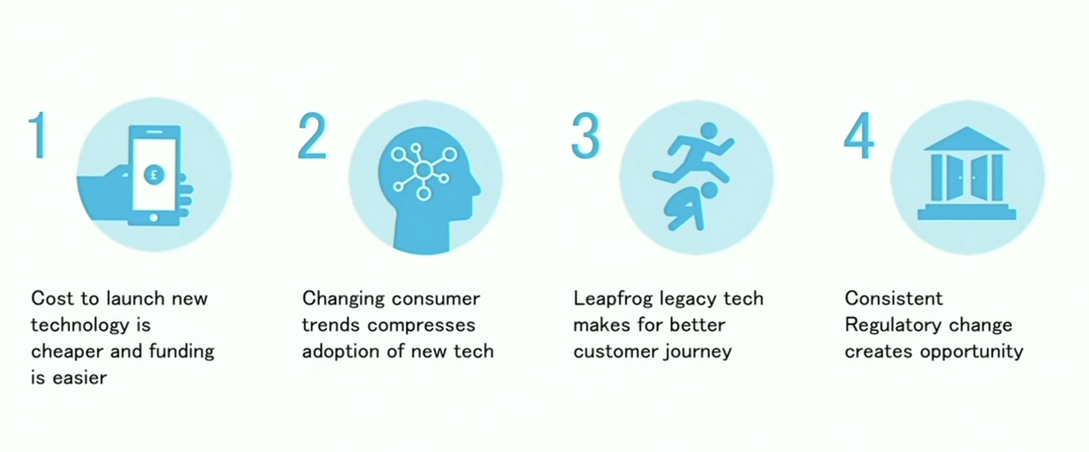
Fintech is accelerating

Slide 6
Power of Customers > High
Client preferences are changing.
It is easier now than ever to change banks.

Slide 7
Threat of Subsitutes > Low

Slide 8
Power of Supplier > Low

Slide 9
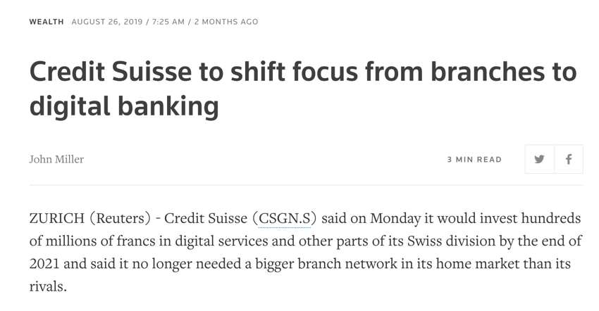
Credit Suisse – Direct Banking Strategy
Transition from High Touch to High Tech
Notes:
https://www.reuters.com/article/us-credit-suisse-direct-banking/credit-suisse-to-shift-focus-from-branches-to-digital-banking-idUSKCN1VG0CD

Slide 10
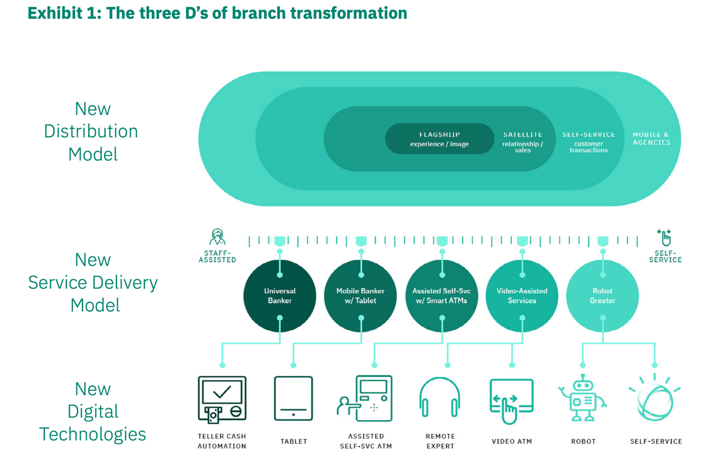
High Touch
High Tech
Universal
Bank
Mobile Banker
w/ Tablet
Assisted
Self-Svc
w/ Smart ATMs
Video-Assisted Services
AI Assisted
Services

Slide 11
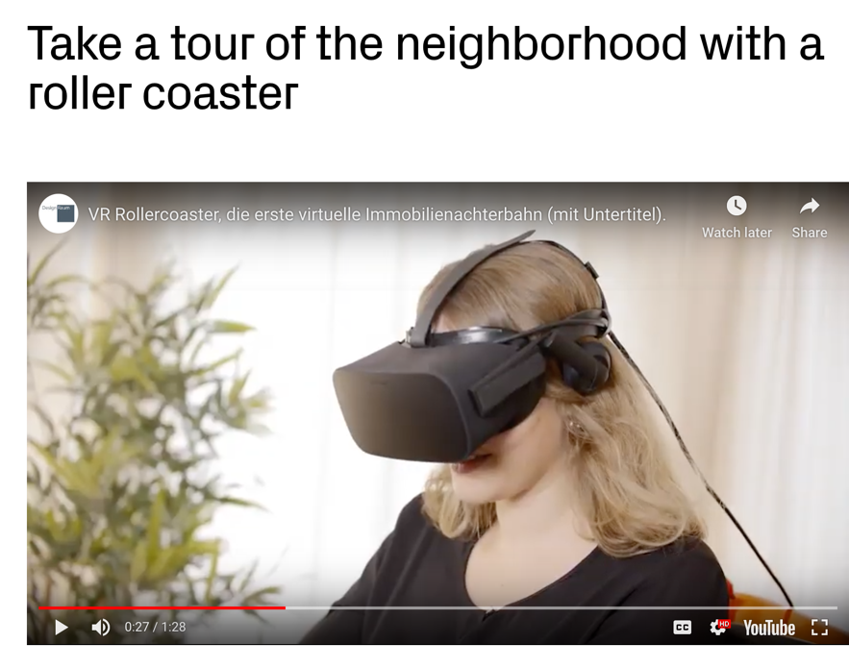
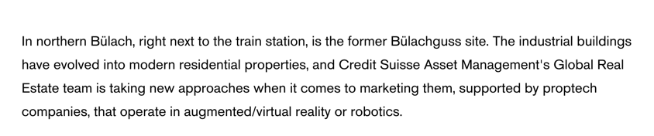
https://www.credit-suisse.com/ch/en/articles/asset-management/innovative-concepts-real-estate-marketing-201910.html

